Slide 1
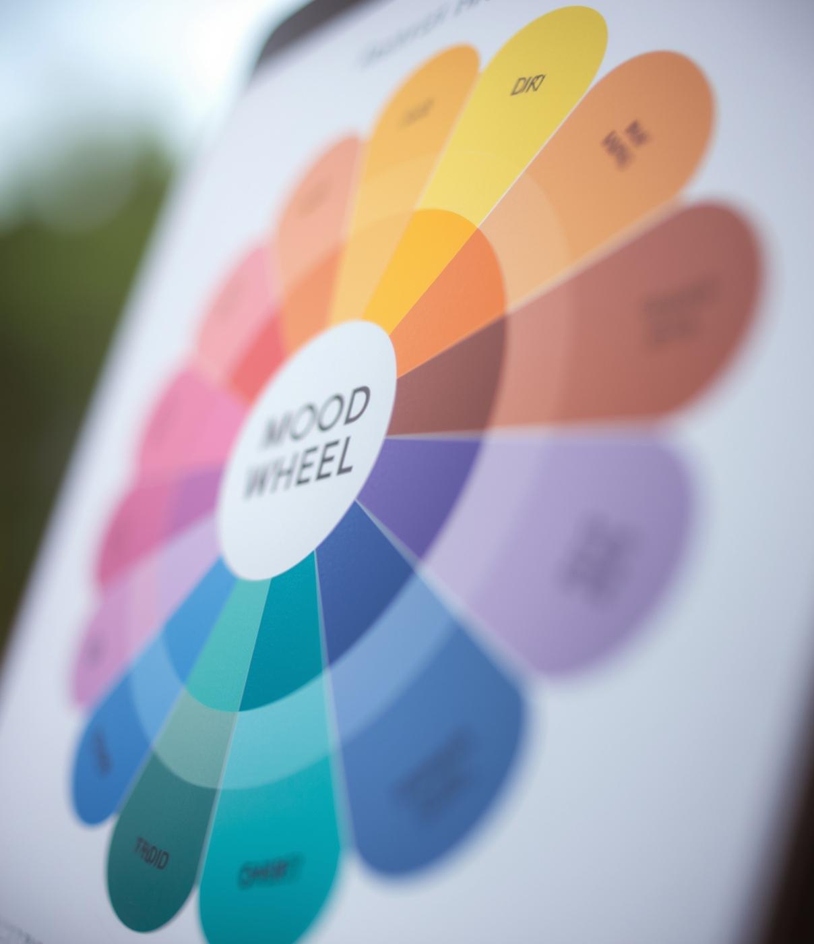

NeuroColor: AI-Based Color Generation
Presented By Nabin Bista

Slide 2
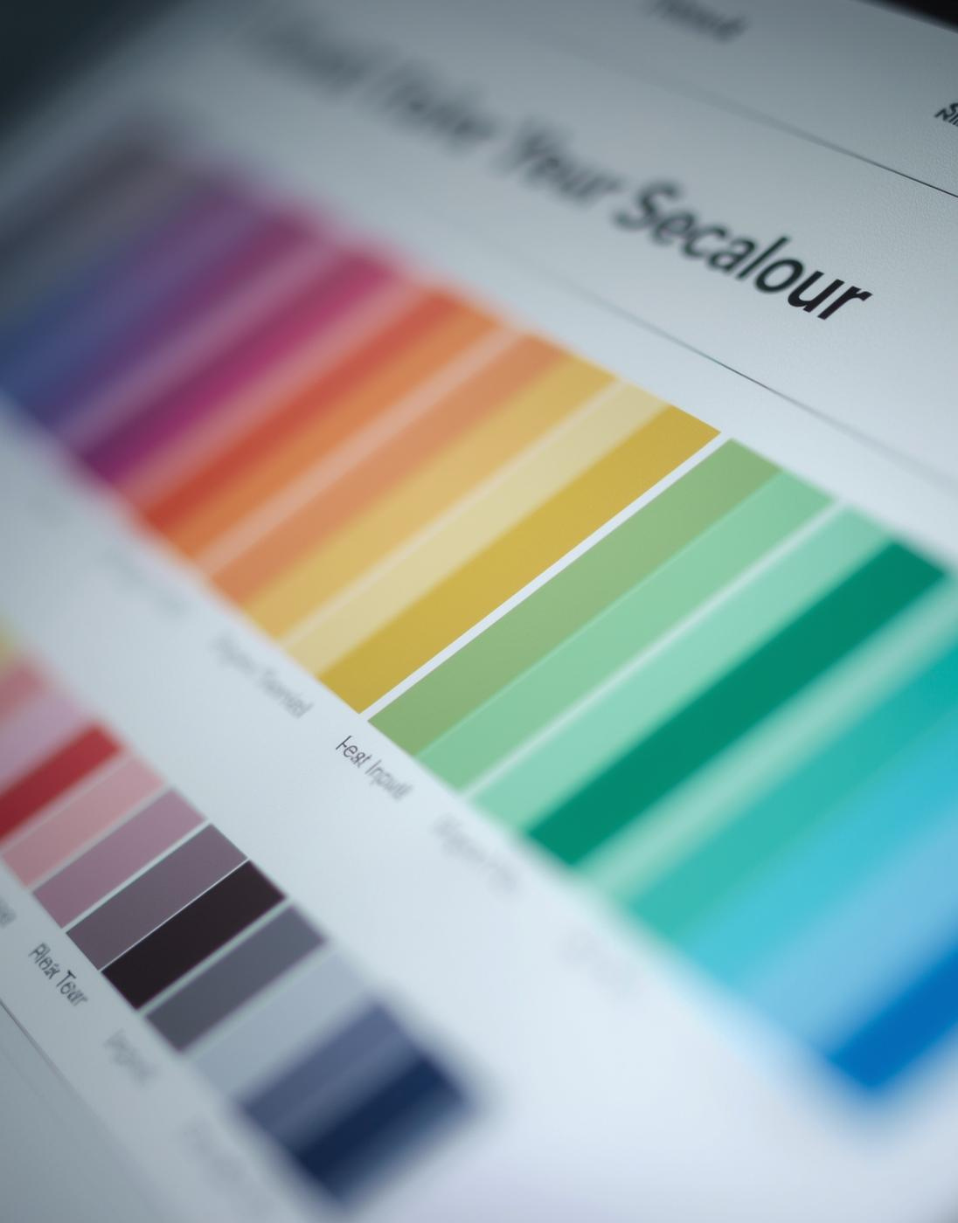
NeuroColor: Transforming Mood Text into Colors
An innovative AI-based color generation tool
NeuroColor utilizes advanced machine learning to predict vibrant RGB color outputs based on user-provided mood descriptions, enhancing user experience across digital platforms with intuitive emotion visualizations.

Slide 3
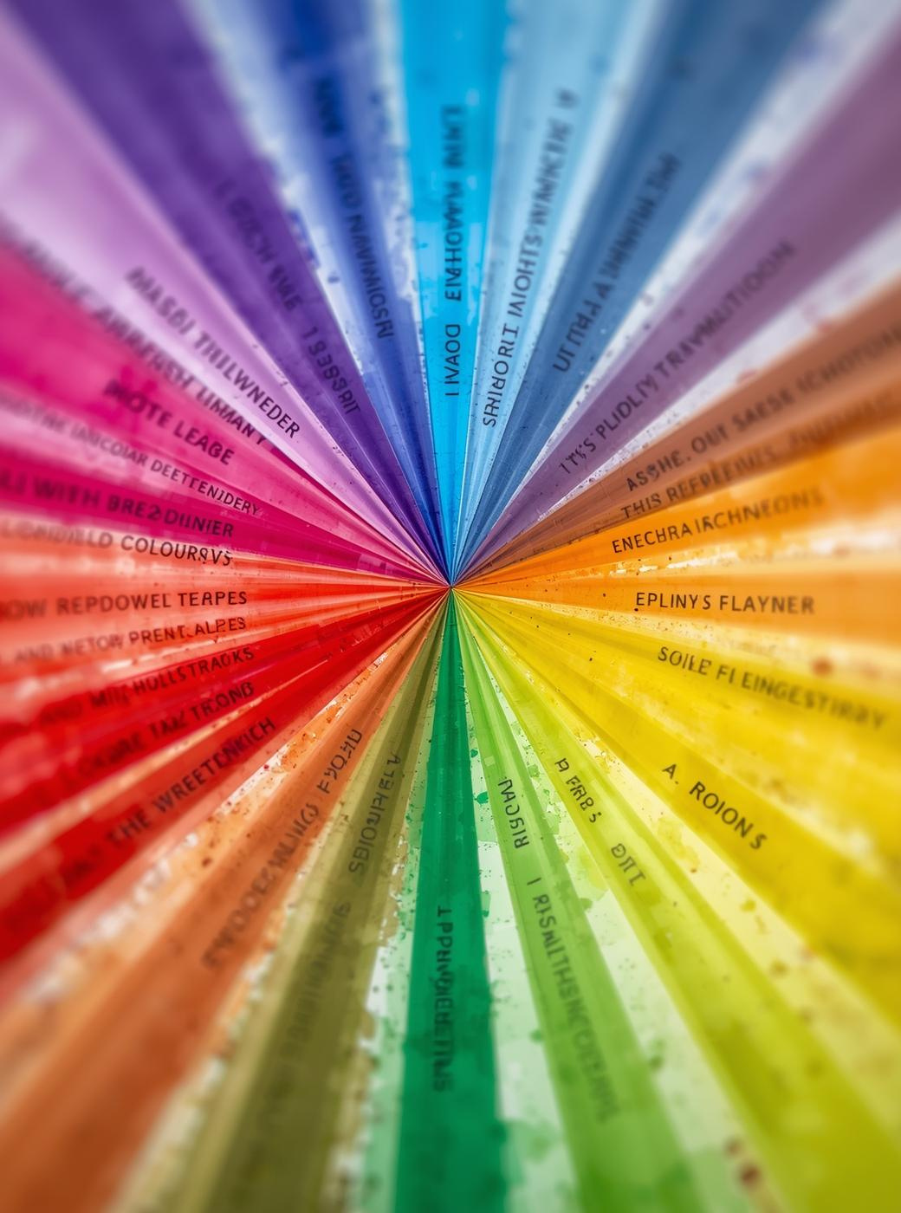

Topic Motivation and Overview
Need for Intuitive Mood Visualization
Enhances user experience significantly
Importance of Mapping Emotions to Colors
Supports emotional understanding and design
Preview of the Presentation Content
Exploring AI concepts and applications

Slide 4



AI Techniques in NeuroColor Project
Learning
Feature
Regression
Supervised learning predicts RGB from mood text.
TF-IDF converts text into numerical vectors.
Support Vector Regressor analyzes high-dimensional data.

Slide 5
Supervised Learning and Multi-Output Regression
Regression
Multi-Output
Regression is essential for predicting RGB values from labeled mood-color pairs, allowing for accurate color representation.
Multi-output regression predicts R, G, and B values simultaneously, enhancing the efficiency of the color generation process.

Slide 6

TF-IDF Feature Extraction
Text Cleaning
Vectorization
Cleaning text involves converting to lowercase and removing punctuation to standardize inputs for analysis.
TF-IDF vectorization transforms mood text into numerical vectors, emphasizing significant words for better predictions.

Slide 7
LinearSVR and Random Forest Regression
LinearSVR
Random Forest
LinearSVR fits a linear hyperplane (linear regression function) that best predicts continuous values by minimizing a regularized ε-insensitive error.
Random Forest regression combines multiple decision trees to improve prediction accuracy and reduce overfitting.

Slide 8

Research Evidence Linking Color to Emotion
Academic Studies on Color-Emotion Associations
Numerous studies, including Kaya & Epps (2004), demonstrate strong measurable links between colors and emotions, highlighting the significance of understanding these associations in affective computing applications.

Slide 9

Reason for Selection Topic
Color choice is important in UI/UX, branding, design, art, but beginners struggle selecting right mood color
A mood-to-color tool can save time and give fast suggestions
It is a simple but practical AI idea that combines NLP + regression in one project
It is a simple but practical AI idea that combines NLP + regression in one project

Slide 10

Preprocessing Mood Text
Text Cleaning and Normalization
Lowercase and punctuation removal
Merging Multiple Text Sources
Combining diverse mood inputs
Preparing for Feature Extraction
Ensuring uniform data structure

Slide 11

Feature Extraction and Model Training
TF-IDF Vectorization Process
Converts text into numerical data
Model Training Techniques Used
Linear SVR and Random Forest
Ensemble Method for Robustness
Comparing model performance effectively

Slide 12

Hyperparameter Tuning and Evaluation
Optimizing Model Performance
Fine-tuning parameters for accuracy
Evaluation Metrics Importance
Assessing model effectiveness and reliability
Model Comparison Insights
Understanding performance across models

Slide 13

Prediction Workflow and Persistence
User Input Processing
Text cleaning and vectorization
Model RGB Prediction
Outputting predicted color values
Model Persistence
Saving for future use

Slide 14
Model Performance Overview
LinearSVR
LinearSVR Tuned (Grid Search CV)
Random Forest
R² = 0.7829
MAE = 27.1867
RMSE = 34.3773
R² = 0.8032
MAE = 25.8164
RMSE = 32.7311 (Best
R² = 0.7417
MAE = 30.6489
RMSE = 37.4988
Result Summary
tuned Linear SVR gives better generalization and lower error

Slide 15



Real-World Applications of NeuroColor Technology
Design
Journaling
Collaboration
Color themes enhance user engagement and interaction.
Mood-driven visuals support mental health awareness.
Teamwork enhances creativity in color application.

Slide 16

Pseudocode for Workflow
Data Handling and Preparation
Load and clean dataset
Model Training Process
Train with MultiOutputRegressor
Prediction and Evaluation
Predict RGB values

Slide 17

Pipeline Overview
Input Data Processing
Cleansing and structuring data
Model Training
Training Support Vector Regressor
Evaluation Metrics
Assessing model performance

Slide 18

Thank You
Any Questions

